Slide 1

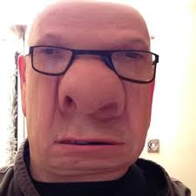

usu
Lesson | Verb | Tense
Grammar | Have got | Present simple
This is Jack. He has got a big nose
You ‘ve got a nice jacket

Slide 2
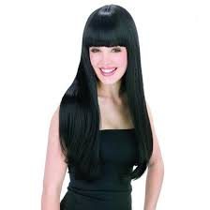
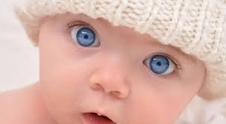
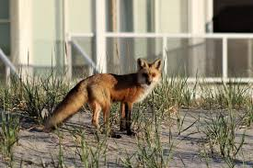
Her name is Nancy, She has got a long black hair
My name is Jimmy I have got blue eyes
The fox has got a long tile

Slide 3
Affirmative form
Full forms | Short forms
I have got | I’ve got
You have got | You’ve got
He has got | He ‘s got
She has got | She’s got
It has got | It’s got
We have got | We’ve got
You have got | You’ve got
They have got | They’ve got

Slide 4
Negative form
Full forms | Short forms
I have not got | I haven’t got
You have not got | Youhaven’t got
He has not got | He hasn’t got
She has not got | She hasn’t got
It has not got | It hasn’t got
We have not got | We haven’t got
You have not got | You haven’t got
They have not got | They haven’t got

Slide 5
