Slide 1

Unit 7
Entertainment

Slide 2
Grammar

Slide 3
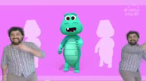
What are they doing?
They are dancing now

Slide 4
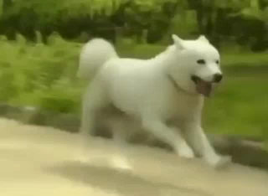
What’s the dog doing at this moment?
The dog is running at this moment

Slide 5
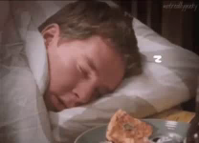
What is he doing right now?
Right now, he is sleeping.

Slide 6
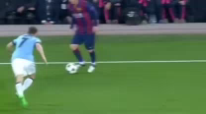
This is Messi
Look! He is playing football very well

Slide 7
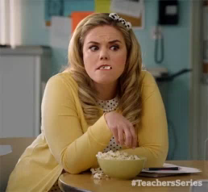
Look! Messi is playing football very well.
She is eating popcorne.
The dog is running at this moment.

Slide 8
Right now, he is sleeping.
They are dancing now.

Slide 9

They are dancing now
Is the action happening in the past?
No, the action is happening in the present.
Present
Do they stop dancing?
continue
No, they continue dancing
PRESENT CONTINUOUS

Slide 10
How to form the present continuous?
She is eating popcorne now.
To be
verb
ing
Present
continuous
Subject
To be
(in simple present)
verb
ing

