Slide 1

Unit 7
Entertainement

Slide 2
Vocabulary

Slide 3
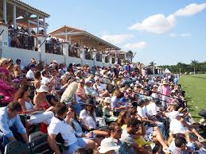
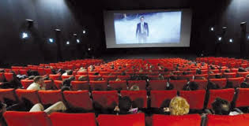
Cinema
spectators
I watch a film in the cinema
There are many spectators in the stadium

Slide 4
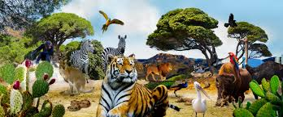
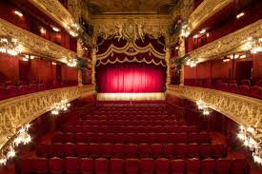
theatre
zoo
theatre
There are many animals in the zoo
I watch a play in the theatre

Slide 5
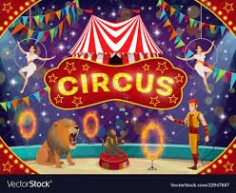
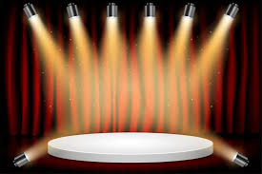
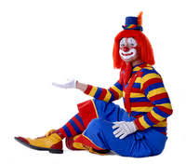
CIRCUS STAGE CLOWN
There is a lion in the circus
The actors act on the stage
The clown is funny

Slide 6
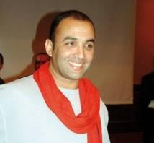
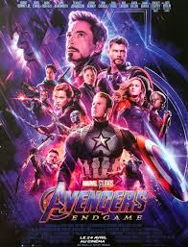
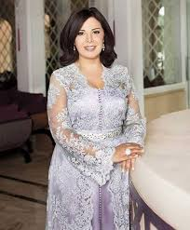
Actor Poster Actress
Rachid Elwali is a Moroccan actor
This is a poster of a film
Mouna Fetou is a Moroccan actress

Slide 7
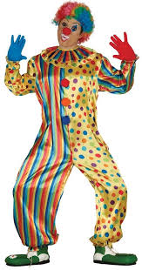
Look at this clown! he is wearing a colourful costum

